Slide 1
Kathryn Funk-Baxter Executive VP for Finance & Administration Texas A&M University-Corpus Christi October 18, 2011

Slide 2
TCC Background Early Days
1993
19 schools with IA Plus
6 schools with Banner

Slide 3
TCC Contract Negotiations to Create Shared Services
1995, 7-Year Contract
DIR Administrator
Software modifications performed centrally for all schools to meet Texas reporting
Annual maintenance split three ways:
SCT
Cover costs of Tech Center – 4 FTEs
Administration fee to DIR

Slide 4
TCC Mission Statement
TCC will develop and maintain software that adds value and provides for standard state and federal reporting requirements, necessary interface programs, implementation of state policies, essential state systems, and modifications that will support uniform software requirements of Texas institutions.
TCC, through a contract with Sungard through the Contract Administrator, protects members’ investment, discounts software license fees, discounts maintenance costs, reduces the escalation fee and provides a Technical Center to support development of value added software to satisfy the needs of the consortium members.

Slide 5
Renewal of contract LEAP to Banner
2002, 7-year contract
First 7 year contract saved 14 million on licenses, maintenance, tech services
Move from IA Plus with a Leap Program to Banner
Incentives to purchase Banner
Tech Center Director replaced, Consortium request to have different leadership model

Slide 6
TCC Major Contract Revision
In 2003, Contract amended and assign to Texas A&M University-Corpus Christi to administer and to be the Contract Administrator for the Statewide SCT software contract between the TCC member institutions and SCT.
Contract Administrator and the TCC will represent all member institutions in the purchase of Sungard software licenses and maintenance.

Slide 7
TCC Over Course of 2003-2009
Modifications to contract
Professional services expanded from Committed services only to include time and materials as well as quality assurances added
Added FTEs with cost sharing from SCT, grew to 9 FTEs
SCT billed schools for consulting & technical hours directly
Added more schools
Early Termination clauses added
Corrected billings and records

Slide 8
TCC Contract Revision - 2010
2010, 6-year contract
Revisions to improve benefits
Licenses at 40% off list, was 30%
3% escalation on maintenance, was split 3% and part 5%
Options to have higher levels of maintenance – Silver and Platinum if school requests
7 FTEs for Tech Center, ability to add other with work orders with termination earlier than contract

Slide 9
TCC Members
39 members - combination of universities and community colleges
37 Banner Student Institutions
18 Banner HR Institutions (CC’s and Univ.)
12 Banner Finance Institutions (Univ. Only)
Each school has representatives to vote on contract amendments, modifications and help bring issues to the Board

Slide 10
TCC Board Members
Bobbie Brown (Chair), Texas Tech University
Mark Adams (Secretary), Sam Houston State University
Becky Gray (Tech Center Liaison), Tarleton State University
Kathryn Funk-Baxter (Contract Admin. Ex-Officio), Texas A&M University-Corpus Christi
Danny Gallant (Treasurer), Stephen F. Austin State University
Larry Mendez (Vice Chair), Tyler Junior College
B. J. Crain, Chief Business Officer, Texas A&M University
Pam Youngblood (Tech Center Liaison), Wharton County Junior College
Cesario Valenzuela, Sul Ross State University

Slide 11
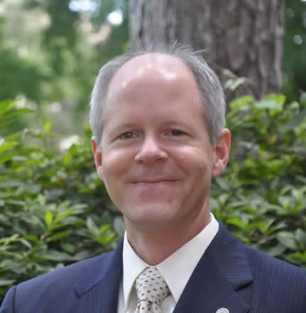
TCC Board Members
Danny Gallant
Stephen F. Austin State University
Mark Adams
Sam Houston State University
Bobbie Brown
Texas Tech University
Larry Mendez
Tyler Junior College
Kathryn Funk-Baxter
Texas A&M University-Corpus Christi
B. J. Crain
Texas A&M University

Slide 12
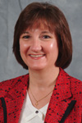
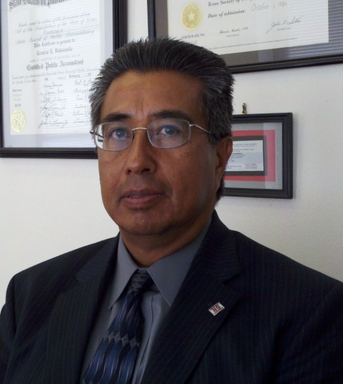
TCC Members
Cesario Valenzuela
Sul Ross State University
Becky Gray
Tarleton State University
Pam Youngblood
Wharton County Junior College

Slide 13
TCC Board Duties
Meet 4 times a year and plans annual meeting for users with presentations
Monitors Tech Center progress towards goals, metrics monitored
Reviews financial position of consortium funds
Requests work orders for additional technical support as needed with consortium funds
Reviews platforms currently supported to maximize resources

Slide 14
TCC Tech Center
TCC Tech Center support currently at 10 FTEs
Additional hours purchased to address needs as determined by Liaisons to serve the needs of entire consortium
FY 2011 delivered 156 projects
73 baseline ERP patches
19 functional specs
38 Texas based solutions
FY 2011 handled 974 calls

Slide 15
Baseline Enhancements

Slide 16
Beta Partners
Beta Partners test modifications
Beta Partners receive incentives

Slide 17
Sungard Future
Sungard serving 2,300 schools and in 40 countries
Merging of Datatel and Sungard Higher Ed in quiet period of regulatory review
CEO named from Datatel management
Datatel was previously owned by this private equity

